Slide 1


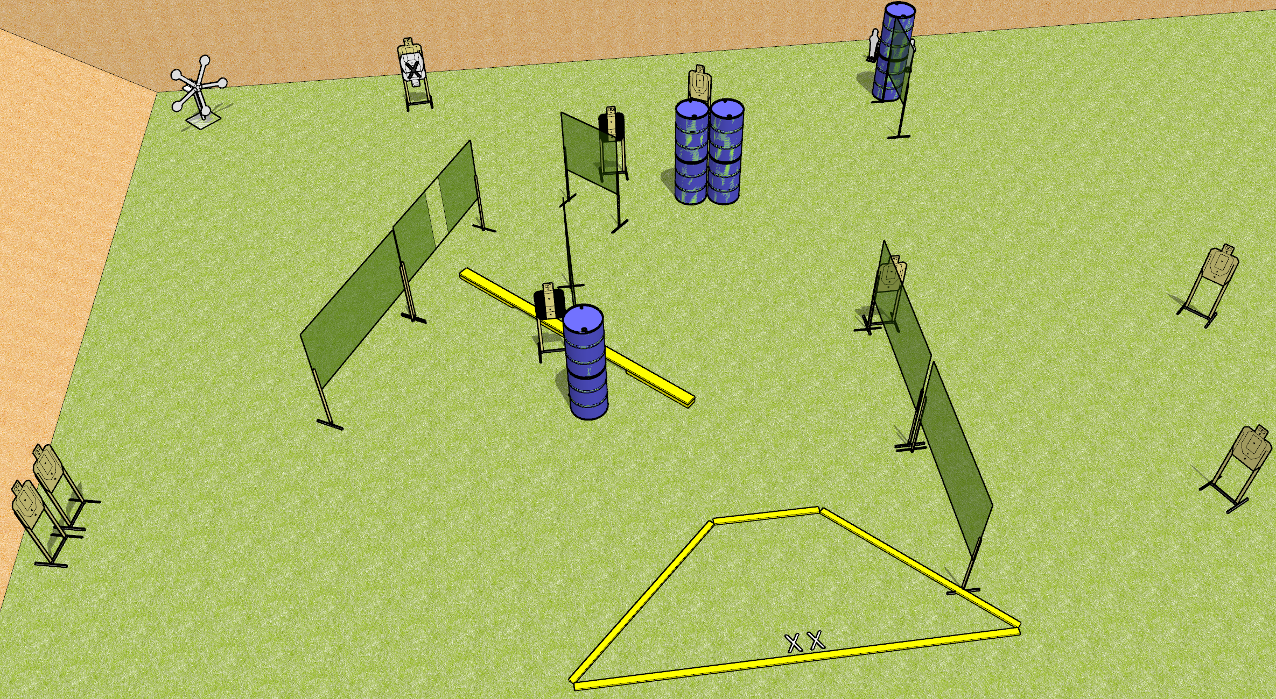
 | Dothan Gun Club – USPSA Match Gamma Rayz Course Designer : Patrick Free
25 rounds 9 USPSA 5 falling plates, 2 mini poppers
Equipment List 1 Texas star 12 wall feet Balance beam 1 medium fault line 2 Tuxedos

Slide 2
Gamma Rayz
Written Stage Briefing
Gamma Rayz is a 25 round, 125 point, Comstock field course. There are 9 USPSA targets, 5 falling plates, and 2 mini poppers. The best 2 hits on paper will score, and steel must fall to score. The start signal is audible.
The balance beam is part of the shooting area.
Handgun start position is both feet on X’s, wrists above shoulders. Handgun is loaded and holstered.
PCC start position is both feet on X’s. Loaded carbine is held with both hands, stock on belt, safety on.
On start signal, engage targets as they become available from within the shooting area.

